Slide 1

Component
Angular Study Group

Slide 2
Agenda
What is component?
Generate component using Angular CLI
File structure of a component
Defining component metadata with a decorator
Component lifecycle hooks
Building nested components
Passing data into a component and getting data from a component

Slide 3
Assuming
We only use one module – Root Module
Study Group Week 6 ->
Angular Module – Call for volunteer

Slide 4
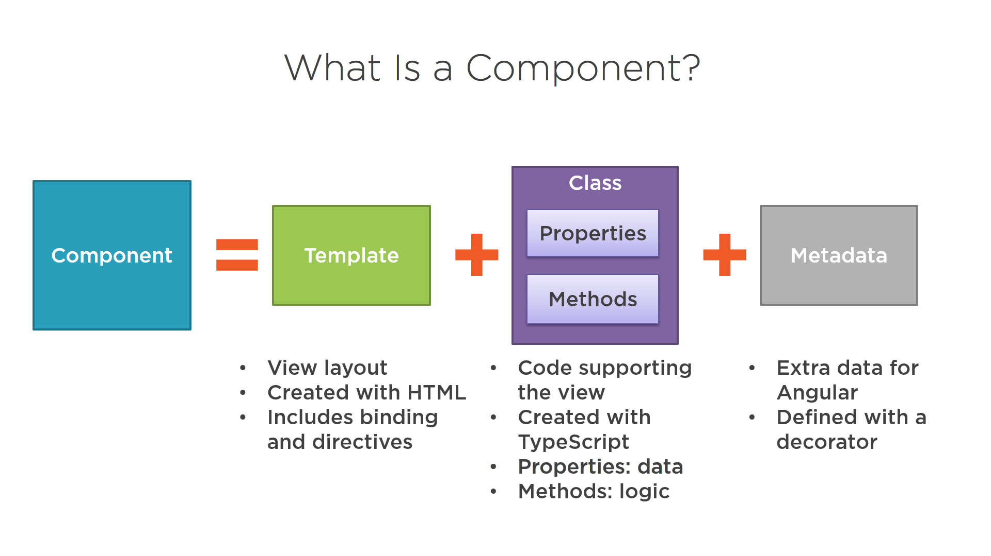

Slide 5
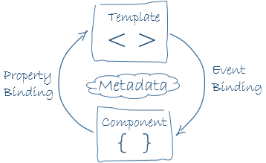
Next session ->
Templates, interpolation and directive by Yin Min

Slide 6
Generate a new component
OR

Slide 7
What you get after generating a component?
Folder
<component name>
Template
<component name>.component.html
<component name>.component.css
Class
<component name>.component.ts
Test file
<component name>.component.spec.ts

Slide 8
File structure
Symbol Name | File Name | HTML Tag
@Component({ ... }) export class AppComponent { } | app.component.ts app.component.html app.component.css | <app-root></app-root>
@Component({ ... }) export class HeroesComponent { } | heroes.component.ts heroes.component.html heroes.component.css | <app-heroes></app-heroes>
@Component({ ... }) export class HeroListComponent { } | hero-list.component.ts hero-list.component.html hero-list.component.css | <app-hero-list></app-hero-list>

Slide 9
Demo – To do list
Generate a component [to do list]

Slide 10
Current app architecture
Root Module
[AppModule]
App Component
<app-root>
App Component
<app-to-do-list>

Slide 11
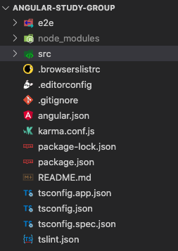
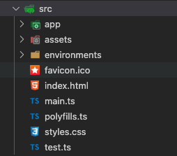
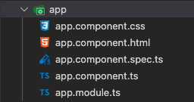
Which folder to put the components

Slide 12
Component Metadata
https://angular.io/api/core/Component#component

Slide 13
Selector

Slide 14
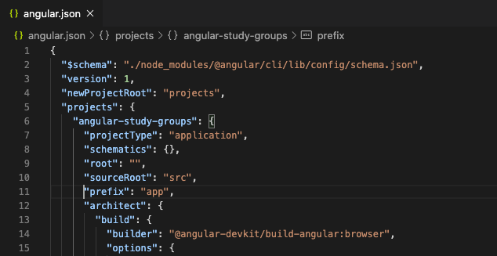
Selector: Change component prefix

Slide 15
Template

Slide 16
Styles

Slide 17
Style Isolation
app-root
To do list
app-to-do-list
Second to do list title

Slide 18
Disable style isolation

Slide 19
Style - :host
app-root
To do list
app-to-do-list
Second to do list title

Slide 20
Style - :host
App Component
<app-root>
:host
App Component
<app-to-do-list>
parent
:host
App Component
<app-to-do-item>
parent

Slide 21
DEMO
Selector
templateUrl & template
stylesUrl & styles
Style isolation
Disable style isolation
:host

Slide 22
Building a nested component
Root Module
[AppModule]
App Component
<app-root>
App Component
<app-to-do-list>
App Component
<app-to-do-item>

Slide 23
One-way binding - @input
Passing value from parent component to child component
App Component
<app-root>
count
App Component
<app-to-do-list>

Slide 24
One-way binding - @output
Emit event from child component to parent component
App Component
<app-root>
count
App Component
<app-to-do-list>

Slide 25
One-way binding - @output
Emit event from child component to parent component
App Component
<app-root>
count
App Component
<app-to-do-list>

Slide 26
Two-way binding: @input & @output
App Component
<app-root>
count
App Component
<app-to-do-list>

Slide 27
Two-way binding: @input & @output
App Component
<app-root>
count
App Component
<app-to-do-list>

Slide 28
DEMO
Parent component passes value to child component
Child component emits event to parent component
Two-way binding

Slide 29
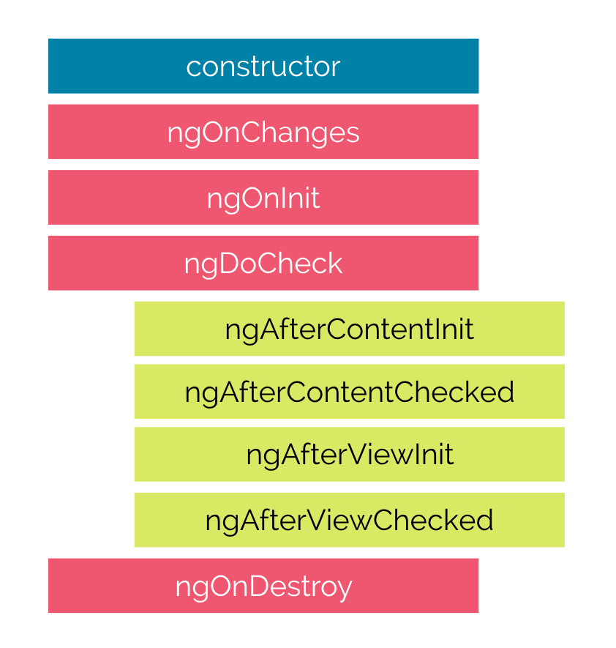

Component Lifecycle Hook

Slide 30
Constructor
Always run first
Dependency injection happen here

Slide 31
ngOnChanges
Called before ngOnInit() and whenever one or more data-bound input properties change.
Note that if your component has no inputs or you use it without providing any inputs, the framework will not call ngOnChanges().

Slide 32
ngOnInit
Called once, after the first ngOnChanges().
Initialize the directive or component after Angular first displays the data-bound properties and sets the directive or component's input properties.

Slide 33
ngDoCheck
Detect and act upon changes that Angular can't or won't detect on its own.
It will be called frequently, it could cause performance issue.
Try to avoid writing code in this lifecycle hook.

Slide 34
ngAfterContentInit
Respond after Angular projects external content into the component's view, or into the view that a directive is in.

Slide 35
ngAfterContentChecked
Respond after Angular checks the content projected into the directive or component.

Slide 36
ngAfterViewInit
Respond after Angular initializes the component's views and child views, or the view that contains the directive.

Slide 37
ngAfterViewChecked
Respond after Angular checks the component's views and child views, or the view that contains the directive.

Slide 38
ngOnDestroy
Cleanup just before Angular destroys the directive or component. Unsubscribe Observables and detach event handlers to avoid memory leaks.

Slide 39
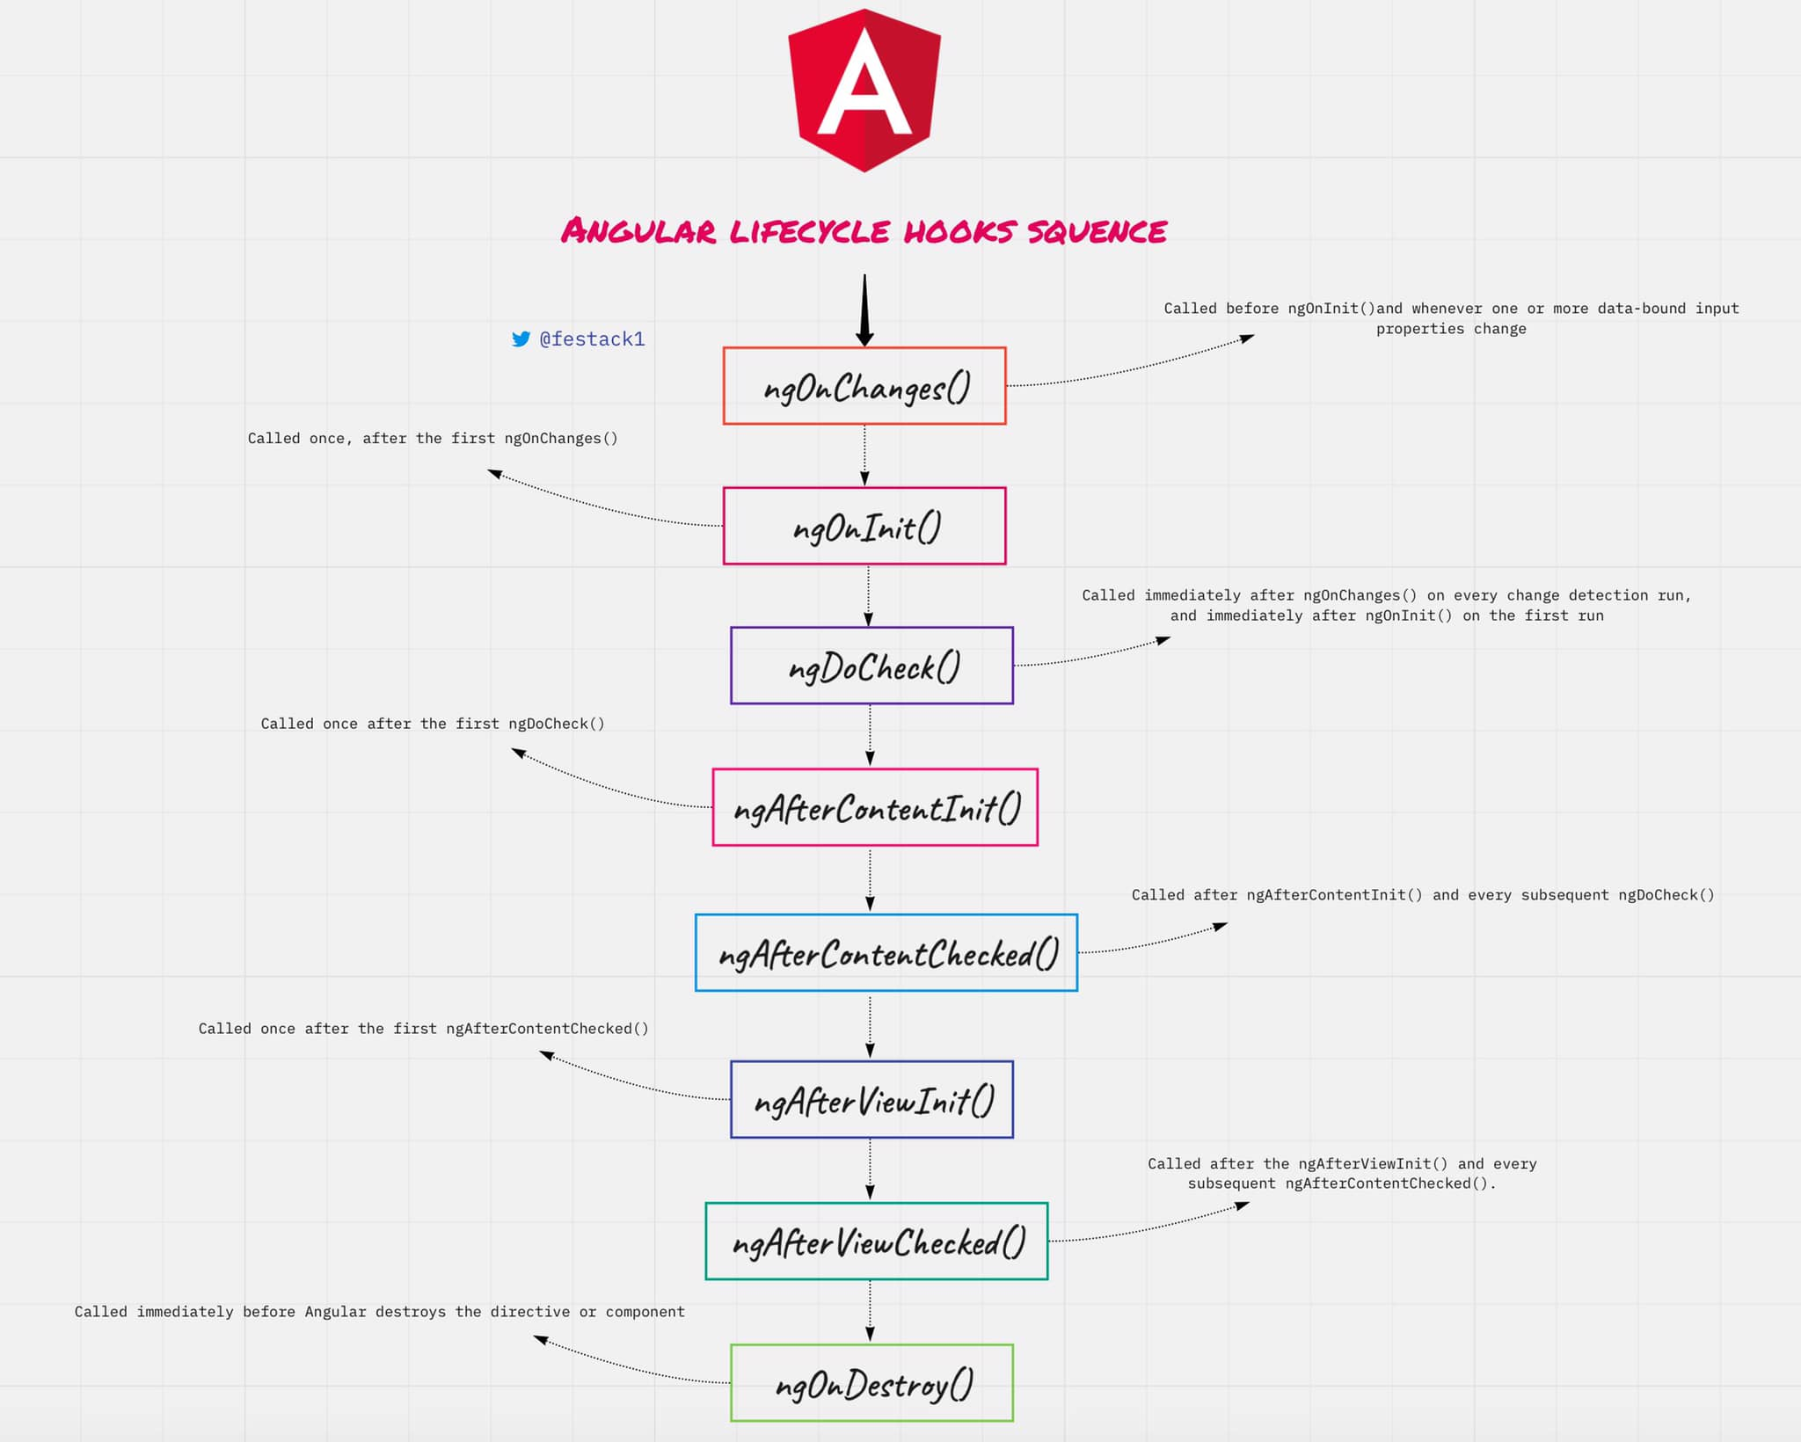

Slide 40
Recap
What is component?
Generate component using Angular CLI
File structure of a component
Defining component metadata with a decorator
Component lifecycle hooks
Building nested components
Passing data into a component and getting data from a component

Slide 41
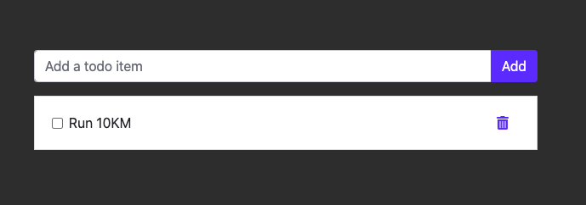
Homework: Create a to-do list
Component: todo-list
Has a textbox to add a new todo item.
Keep a list of todo list
Component: todo-item
Accept input from the parent component
Allow user to flag this task to done by checking the checkbox, emit the event to parent component to change it
Allow user to delete this task, emit event to parent component to delete the todo item.

Slide 42
Homework: Todo list architecture
Root Module
[AppModule]
App Component
<app-root>
App Component
<app-to-do-list>
App Component
<app-to-do-item>

Slide 43
Answer
https://github.com/hongtat88/angular-study-group-component

Slide 44
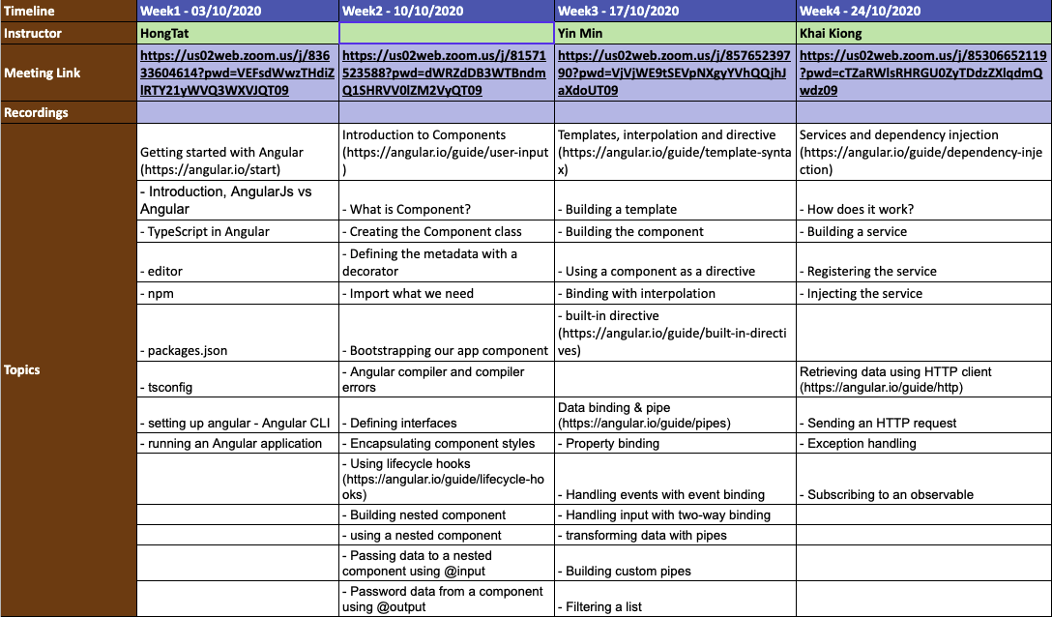
HongTat

Slide 45
